Slide 1
YOUR BANK

Slide 2
Under The Guidance Of Hemant Brave
Budidha Sravani
Kukka Umamaheshwari
Komal Vithal Kamithkar
Kadiyala Hemasri Allasai
Axis Batch-10

Slide 3
Table Of Contents
Introduction
Requirements
Technologies
Service Names – Port Numbers
Flow Chart
Demo
Conclusion

Slide 4
Introduction
Your Bank Learning management systems, or YB LMS, are software platforms designed to manage, distribute and track employee training. They are often used in corporate settings to deliver online courses and track employee progress. However, they can also be used in other ways, such as to provide compliance training or customer education.

Slide 5







Requirements
Hardware Requirements: -
Windows OS
8GB Ram
Internet
Software Requirements: -

Slide 6






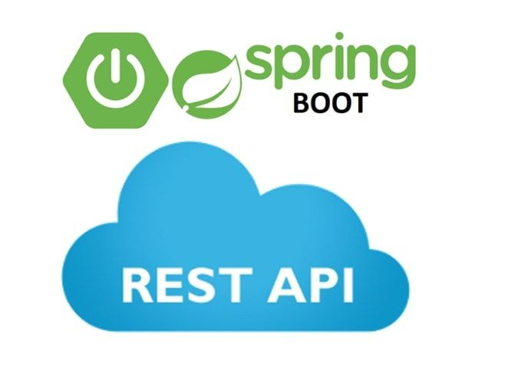
Technologies
Front-end: -
Databases: -
Back-end: -

Slide 7
Service Names – Port Numbers
Eureka Server - 8761
Api Gateway - 9000
AdminMicroService - 9003
EmployeeService - 9002
Salary - 9007
JobOppurtunities - 8031
LiveProjects-Service - 9008
NotificationService - 8083
StakeHolders-Service - 8081
SupportTeam-Service - 9003

Slide 8
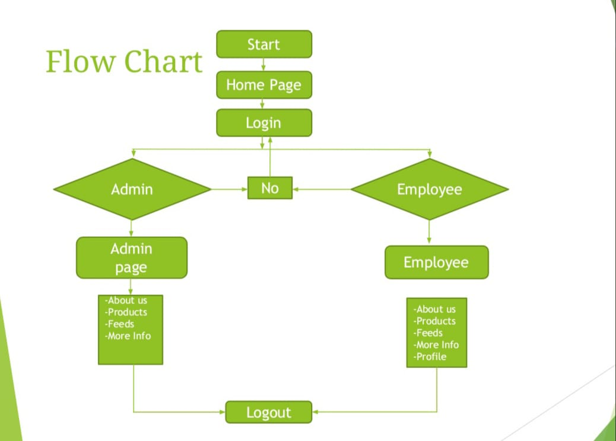

Slide 9
Demo

Slide 10
THANK YOU

